Slide 1
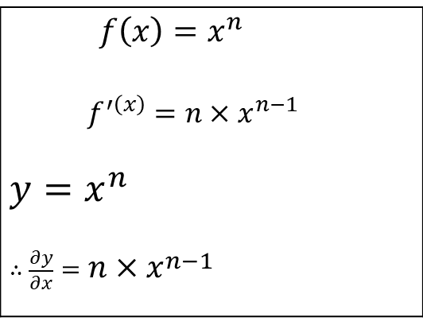



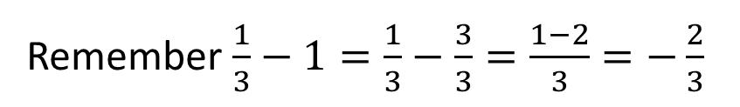
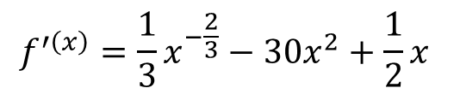
Derivatives
$f\left(x\right)=x^{n}$ $f^{′\left(x\right)}=n×x^{n−1}$ $y=x^{n}$ $∴\frac{∂y}{∂x}=n×x^{n−1}$
$$f^{′\left(x\right)}=\frac{1}{3}x^{−\frac{2}{3}}−30x^{2}+\frac{1}{2}x$$
Remember $\frac{1}{3}−1=\frac{1}{3}−\frac{3}{3}=\frac{1−2}{3}=−\frac{2}{3}$
$f′\left(100\right)$ $=0$
$$f′\left(x\right)=3x^{2}+8x^{3}−3$$

Slide 2

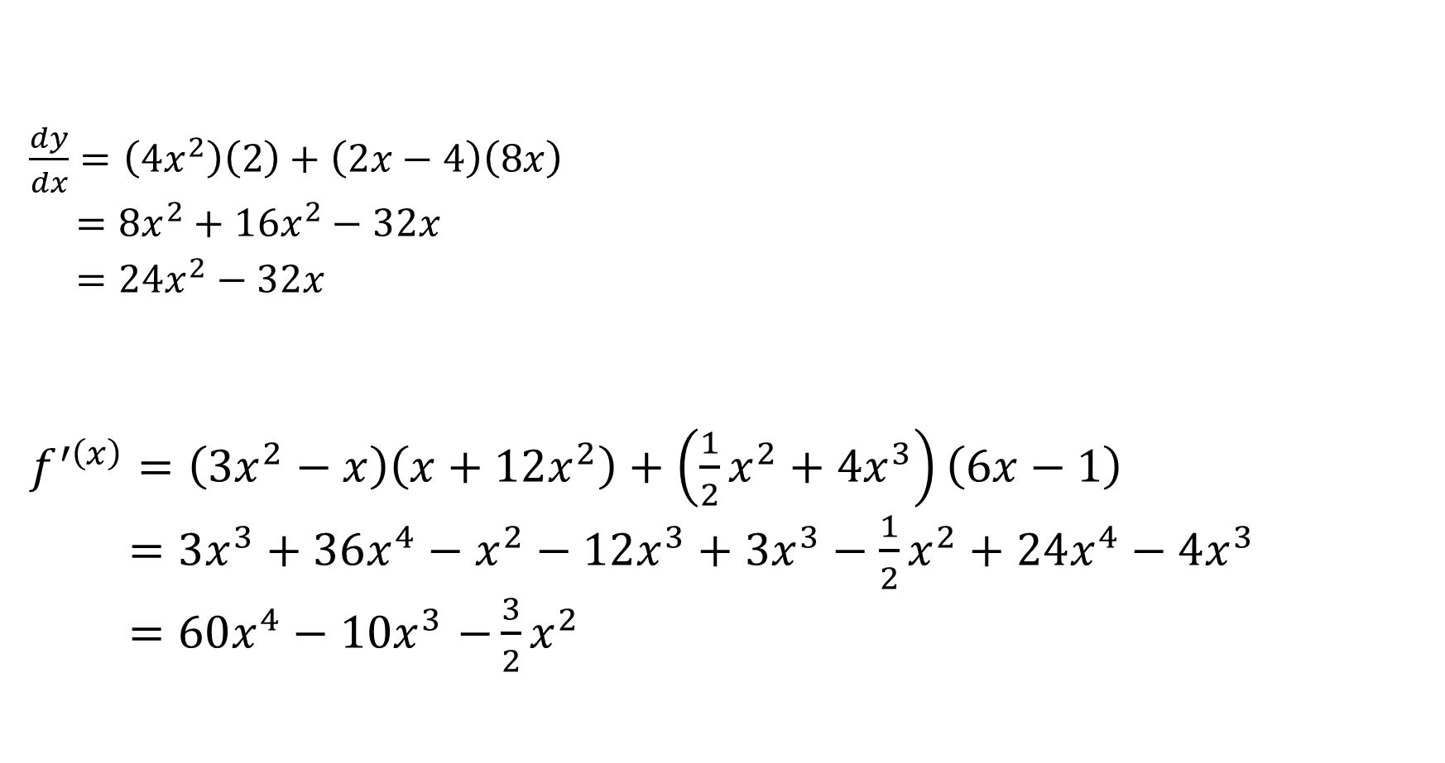

Product rule
$\frac{dy}{dx}=\left({4x}^{2}\right)\left(2\right)+\left(2x−4\right)\left(8x\right)$
$={8x}^{2}+{16x}^{2}−32x$
$=24x^{2}−32x$
$f^{′\left(x\right)}=\left(3x^{2}−x\right)\left(x+12x^{2}\right)+\left({\frac{1}{2}x}^{2}+4x^{3}\right)\left(6x−1\right)$
$=3x^{3}+36x^{4}−x^{2}−12x^{3}+3x^{3}−{\frac{1}{2}x}^{2}+24x^{4}−4x^{3}$
${=60x^{4}−10x}^{3}−\frac{3}{2}x^{2}$
$$1.$$
$$2.$$

Slide 3
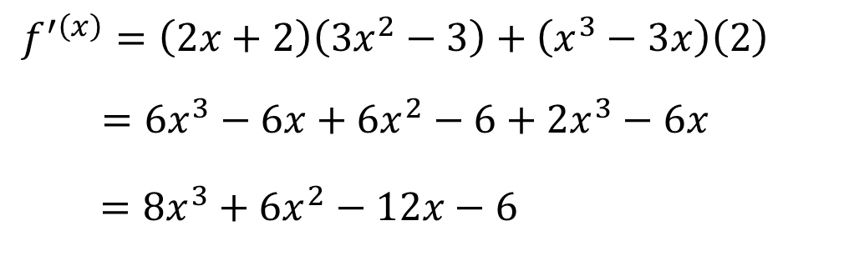

$$1.$$
$f^{′\left(x\right)}=\left(2x+2\right)\left(3x^{2}−3\right)+\left(x^{3}−3x\right)\left(2\right)$
$=6x^{3}−6x+6x^{2}−6+{2x}^{3}−6x$
$=8x^{3}+6x^{2}−12x−6$

Slide 4


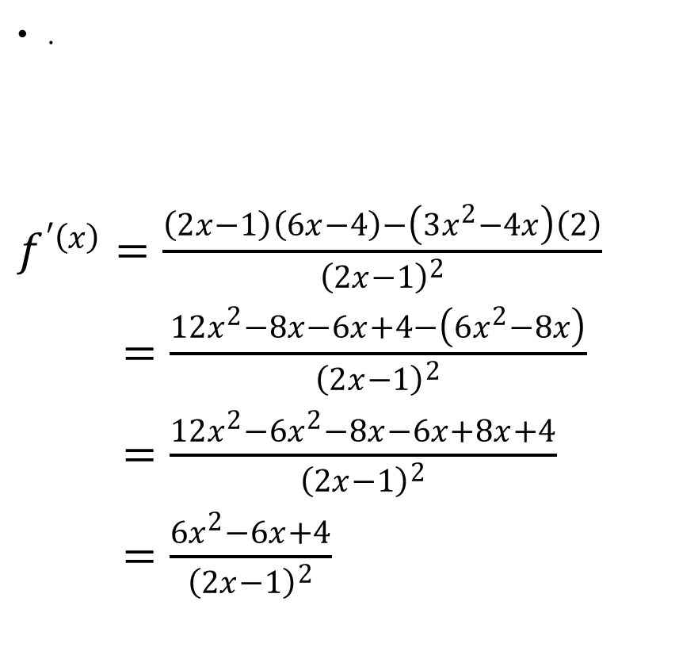

Quotient Rule
.
$f^{′\left(x\right)}=\frac{\left(2x−1\right)\left(6x−4\right)−\left(3x^{2}−4x\right)\left(2\right)}{{\left(2x−1\right)}^{2}}$
$=\frac{12x^{2}−8x−6x+4−\left(6x^{2}−8x\right)}{{\left(2x−1\right)}^{2}}$
$=\frac{12x^{2}−6x^{2}−8x−6x+8x+4}{{\left(2x−1\right)}^{2}}$
$=\frac{6x^{2}−6x+4}{{\left(2x−1\right)}^{2}}$
$$2.$$
$$1.$$
$=\frac{\left(x+3\right)\left(6x\right)−\left({3x}^{2}−1\right)\left(1\right)}{{\left(x+3\right)}^{2}}$
$=\frac{{6x}^{2}+18x−\left({3x}^{2}−1\right)}{{\left(x+3\right)}^{2}}$
$=\frac{{6x}^{2}+18x−{3x}^{2}+1}{{\left(x+3\right)}^{2}}$
$=\frac{{3x}^{2}+18x+1}{{\left(x+3\right)}^{2}}$

Slide 5
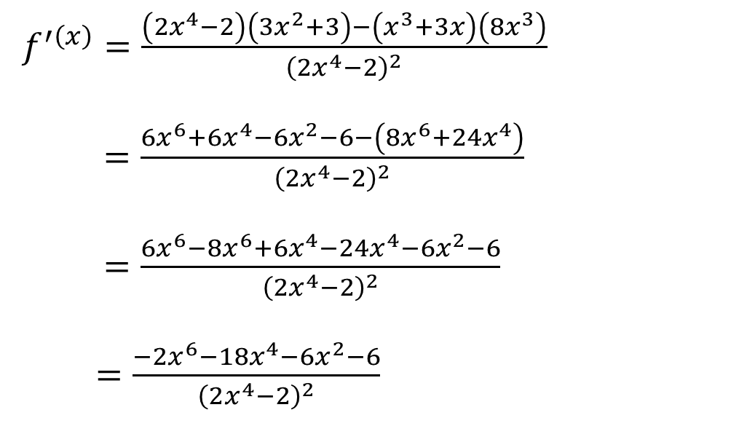
$f^{′\left(x\right)}=\frac{\left(2x^{4}−2\right)\left(3x^{2}+3\right)−\left(x^{3}+3x\right)\left(8x^{3}\right)}{{\left(2x^{4}−2\right)}^{2}}$
$=\frac{6x^{6}+6x^{4}−6x^{2}−6−\left(8x^{6}+24x^{4}\right)}{{\left(2x^{4}−2\right)}^{2}}$
$=\frac{6x^{6}−8x^{6}+6x^{4}−24x^{4}−6x^{2}−6}{{\left(2x^{4}−2\right)}^{2}}$
$=\frac{−2x^{6}−18x^{4}−6x^{2}−6}{{\left(2x^{4}−2\right)}^{2}}$

Slide 6

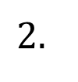

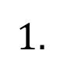
Chain Rule
$f^{′\left(x\right)}=3{\left(3x^{2}−4x\right)}^{2}\left(6x−4\right)$
$=\left(18x−12\right){\left(3x^{2}−4x\right)}^{2}$
.
$f^{′\left(x\right)}=6{\left(x^{2}+3\right)}^{5}\left(2x\right)$
$=12x{\left(x^{2}+3\right)}^{5}$
$$2.$$
$$1.$$

Slide 7
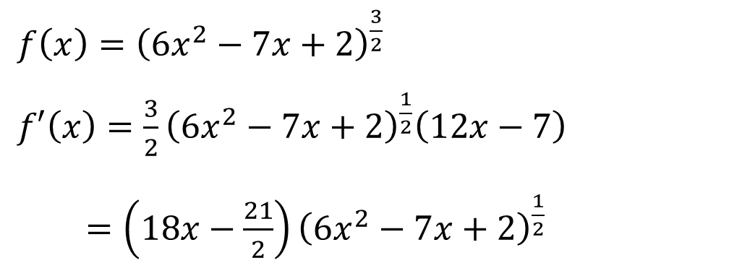
$f\left(x\right)={\left(6x^{2}−7x+2\right)}^{\frac{3}{2}}$
$f′\left(x\right)=\frac{3}{2}{\left(6x^{2}−7x+2\right)}^{\frac{1}{2}}\left(12x−7\right)$
$=\left(18x−\frac{21}{2}\right){\left(6x^{2}−7x+2\right)}^{\frac{1}{2}}$

Slide 8
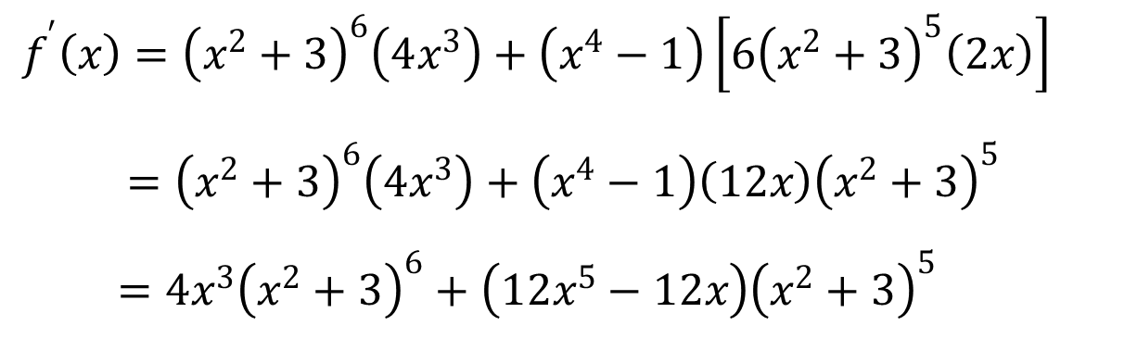
Combination
$f^{′}\left(x\right)={\left(x^{2}+3\right)}^{6}\left(4x^{3}\right)+\left(x^{4}−1\right)\left[6{\left(x^{2}+3\right)}^{5}\left(2x\right)\right]$
$={\left(x^{2}+3\right)}^{6}\left(4x^{3}\right)+\left(x^{4}−1\right)\left(12x\right){\left(x^{2}+3\right)}^{5}$
$=4x^{3}{\left(x^{2}+3\right)}^{6}+\left(12x^{5}−12x\right){\left(x^{2}+3\right)}^{5}$

Slide 9
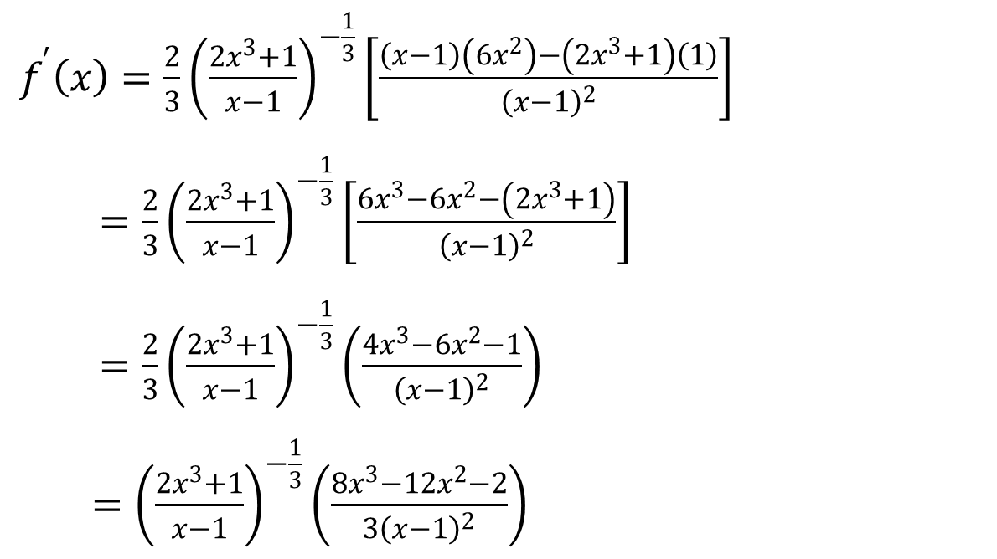
$f^{′}\left(x\right)=\frac{2}{3}{\left(\frac{2x^{3}+1}{x−1}\right)}^{−\frac{1}{3}}\left[\frac{\left(x−1\right)\left(6x^{2}\right)−\left(2x^{3}+1\right)\left(1\right)}{{\left(x−1\right)}^{2}}\right]$
$=\frac{2}{3}{\left(\frac{2x^{3}+1}{x−1}\right)}^{−\frac{1}{3}}\left[\frac{6x^{3}−6x^{2}−\left(2x^{3}+1\right)}{{\left(x−1\right)}^{2}}\right]$
$=\frac{2}{3}{\left(\frac{2x^{3}+1}{x−1}\right)}^{−\frac{1}{3}}\left(\frac{4x^{3}−6x^{2}−1}{{\left(x−1\right)}^{2}}\right)$
$={\left(\frac{2x^{3}+1}{x−1}\right)}^{−\frac{1}{3}}\left(\frac{8x^{3}−12x^{2}−2}{{3\left(x−1\right)}^{2}}\right)$

Slide 10
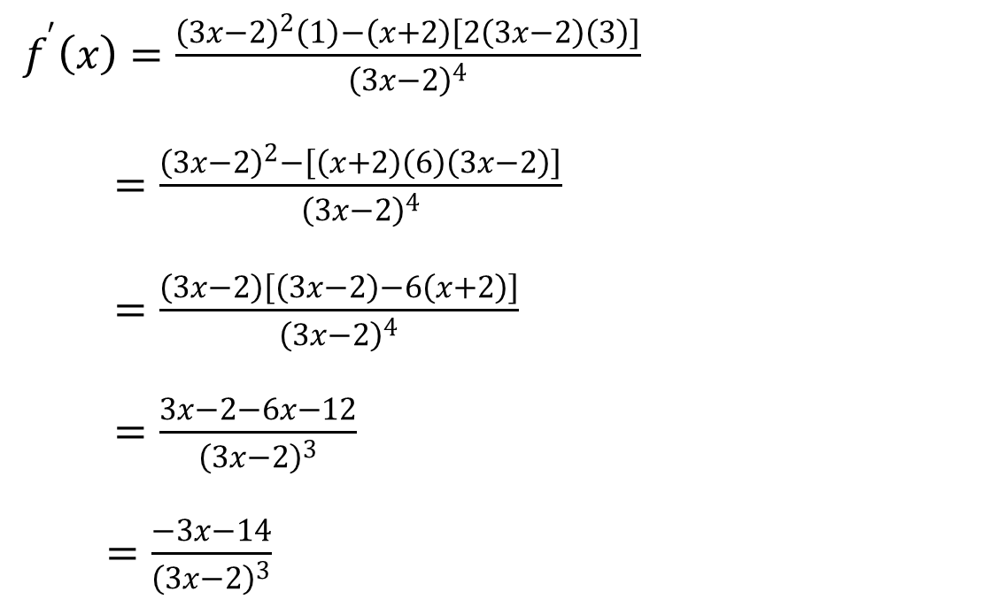
$f^{′}\left(x\right)=\frac{{\left(3x−2\right)}^{2}\left(1\right)−\left(x+2\right)\left[2\left(3x−2\right)\left(3\right)\right]}{{\left(3x−2\right)}^{4}}$
$=\frac{{\left(3x−2\right)}^{2}−\left[\left(x+2\right)\left(6\right)\left(3x−2\right)\right]}{{\left(3x−2\right)}^{4}}$
$=\frac{\left(3x−2\right)\left[\left(3x−2\right)−6\left(x+2\right)\right]}{{\left(3x−2\right)}^{4}}$
$=\frac{3x−2−6x−12}{{\left(3x−2\right)}^{3}}$
$=\frac{−3x−14}{{\left(3x−2\right)}^{3}}$

Slide 11
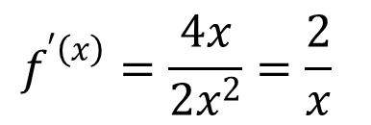
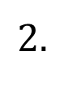
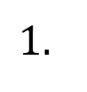
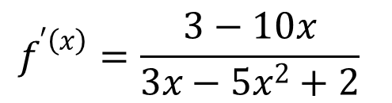
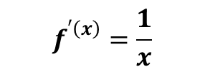
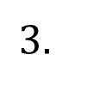
Derivative Of ln (Natural log)
$$1.$$
$$2.$$
$$f^{′\left(x\right)}=\frac{1}{x}$$
$$f^{′\left(x\right)}=\frac{4x}{2x^{2}}=\frac{2}{x}$$
$$3.$$
$$f^{′\left(x\right)}=\frac{3−10x}{3x−5x^{2}+2}$$

Slide 12
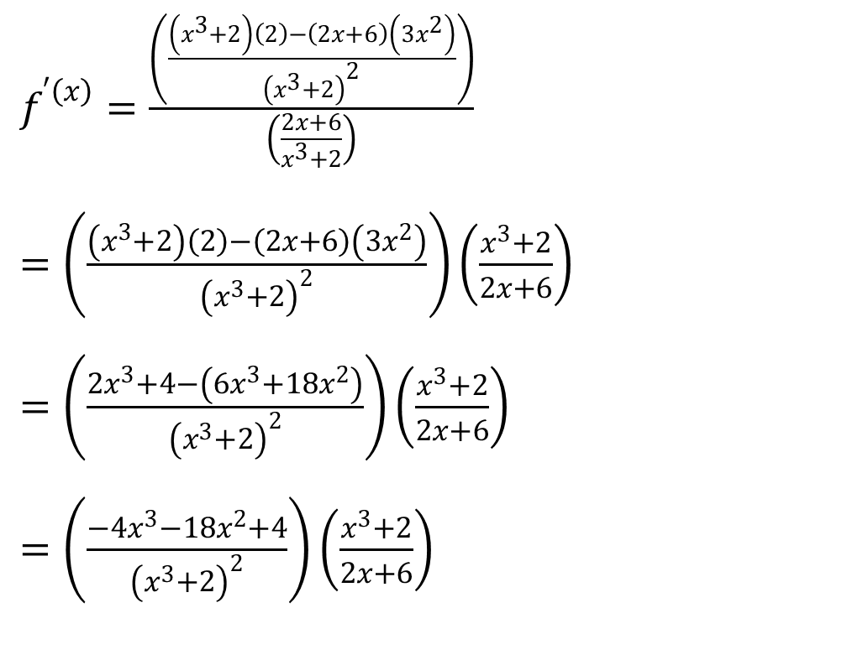
$f^{′\left(x\right)}=\frac{\left(\frac{\left(x^{3}+2\right)\left(2\right)−\left(2x+6\right)\left(3x^{2}\right)}{{\left(x^{3}+2\right)}^{2}}\right)}{\left(\frac{2x+6}{x^{3}+2}\right)}$
$=\left(\frac{\left(x^{3}+2\right)\left(2\right)−\left(2x+6\right)\left(3x^{2}\right)}{{\left(x^{3}+2\right)}^{2}}\right)\left(\frac{x^{3}+2}{2x+6}\right)$
$=\left(\frac{2x^{3}+4−\left(6x^{3}+18x^{2}\right)}{{\left(x^{3}+2\right)}^{2}}\right)\left(\frac{x^{3}+2}{2x+6}\right)$
$=\left(\frac{−4x^{3}−18x^{2}+4}{{\left(x^{3}+2\right)}^{2}}\right)\left(\frac{x^{3}+2}{2x+6}\right)$

Slide 13
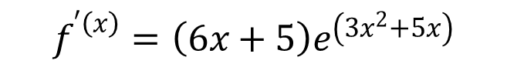
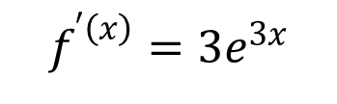


Derivative of e
$1$.
$2$.
$$f^{′\left(x\right)}=3e^{3x}$$
$$f^{′\left(x\right)}=\left(6x+5\right)e^{\left(3x^{2}+5x\right)}$$

Slide 14
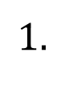
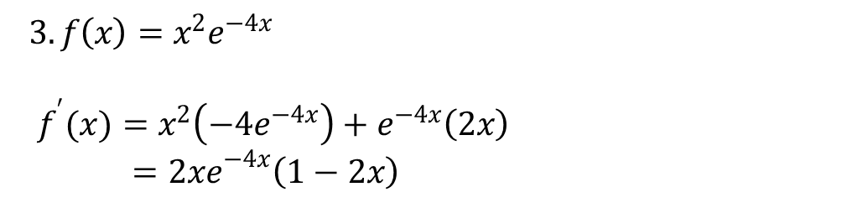
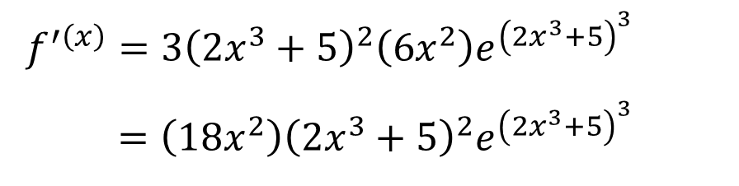
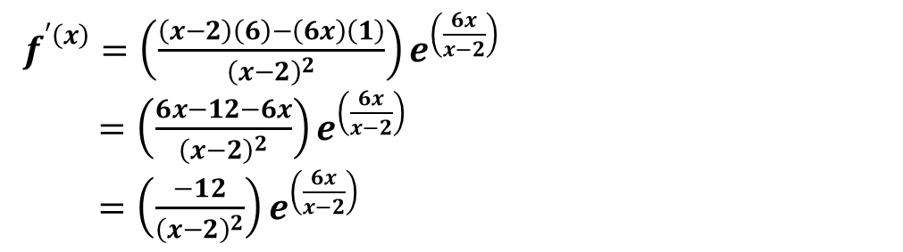
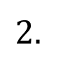
$3. f\left(x\right)=x^{2}e^{−4x}$
$f^{′}(x)=x^{2}\left(−4e^{−4x}\right)+e^{−4x}\left(2x\right)$
$={2xe}^{−4x}\left(1−2x\right)$
$$1.$$
$f^{′\left(x\right)}=3{\left(2x^{3}+5\right)}^{2}\left(6x^{2}\right)e^{{\left(2x^{3}+5\right)}^{3}}$
$=\left(18x^{2}\right){\left(2x^{3}+5\right)}^{2}e^{{\left(2x^{3}+5\right)}^{3}}$
$$2.$$
$f^{′\left(x\right)}=\left(\frac{\left(x−2\right)\left(6\right)−\left(6x\right)\left(1\right)}{{\left(x−2\right)}^{2}}\right)e^{\left(\frac{6x}{x−2}\right)}$
$=\left(\frac{6x−12−6x}{{\left(x−2\right)}^{2}}\right)e^{\left(\frac{6x}{x−2}\right)}$
$=\left(\frac{−12}{{\left(x−2\right)}^{2}}\right)e^{\left(\frac{6x}{x−2}\right)}$

Slide 15

2nd and 3rd order derivatives
$f\left(x\right)={{2x}^{4}+x}^{3}−3x+100$
$f^{′}\left(x\right)=8x^{3}+3x^{2}−3$
$f^{′′}\left(x\right)=24x^{2}+6x$
$f^{3} \left(x\right)=48x+6$
$2. f\left(x\right)={{2x}^{4}+x}^{3}−3x+100$ find $f^{3} \left(2\right)$
$f^{3} \left(2\right)=48\left(2\right)+6=102$

